Slide 1
Occupancy detection data
Engineering Clinic
By.
Meghavarshine (18BIT010)
Mirudula laxmi (18BIT205)
Priyadharshini (18BIT009)

Slide 2

Dataset details
Dataset was downloaded from https://www.kaggle.com/datasets
Dataset : Room Occupancy
Dataset type: Classification
Dataset link : https://www.kaggle.com/sachinsharma1123/room-occupancy

Slide 3
Introduction
Experimental data used for binary classification (room occupancy) from Temperature,Humidity,Light and CO2. Ground-truth occupancy was obtained from time stamped pictures that were taken every minute.
This dataset contains 6 attributes in which 5 are feature and 1 is target variable:
Temperature
Humidity
Light
Carbon dioxide(CO2)
Humidity Ratio
Occupancy - > Target Variable:
1-if there is chances of room occupancy.
0-No chances of room occupancy
Dataset type: Classification dataset
Missing values: none
With this data we can predict whether the room is occupied or not

Slide 4
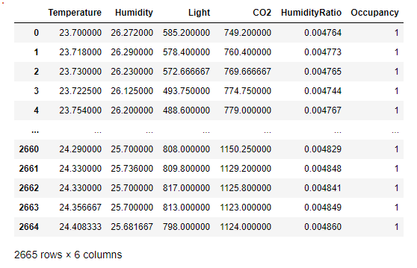

Slide 5
Techniques used:
Algorithms –
Decision tree,
Logistic regression,
K nearest neighbors,
Naïve Bayes
Pre-Processing Techniques-
Rescaling
Binarization
Feature selection Techniques:
univariate selection
Recursive feature elimination
Principal component analysis

Slide 6
Data Visualization

Slide 7
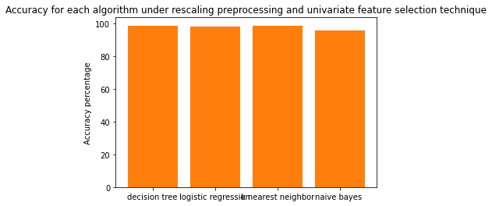
Preprocessing Technique - Rescaling and Feature selection technique - univariate
[98.65,97.90,98.35,95.65]

Slide 8
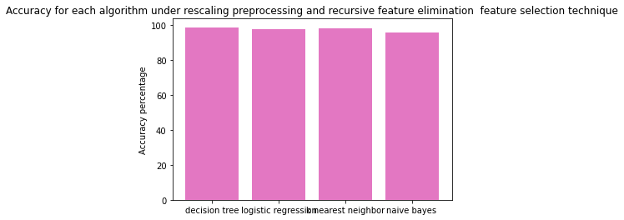
Preprocessing Technique - Rescaling and Feature selection technique recursive feature elimination
[98.80,97.90,98.35,95.65]

Slide 9
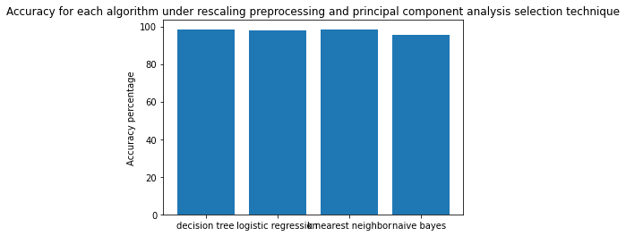
Preprocessing Technique - Rescaling and Feature selection technique - principal component analysis
[98.50,97.90,98.35,95.65]

Slide 10
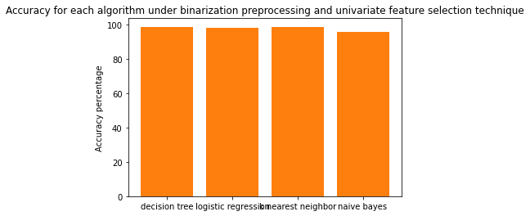
Preprocessing Technique - Binarization and Feature selection technique - univariate
[98.65,97.90,98.35,95.65]

Slide 11
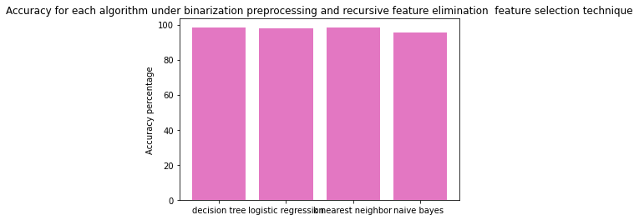
Preprocessing Technique - Binarization and Feature selection technique -recursive feature elimination
[98.50,97.90,98.35,95.65]

Slide 12
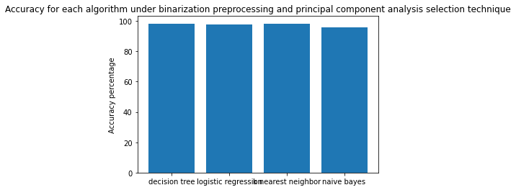
Preprocessing Technique - Binarization and Feature selection technique -univariate principal component analysis [98.20,97.90,98.35,95.65]

Slide 13
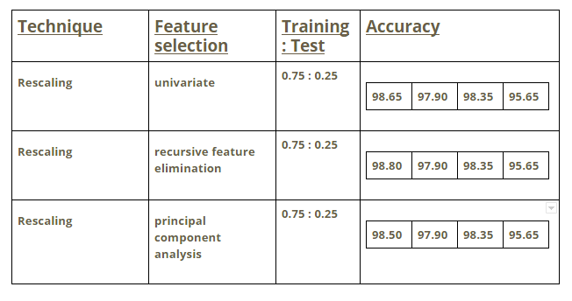
Inference:
In Accuracy order of algorithm used: Decision tree, Logistic regression, K nearest neighbors, Naïve Bayes

Slide 14
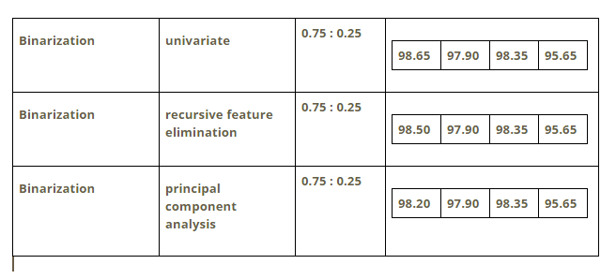

Slide 15
Result:
By referring to the above table we can say that Decision tree algorithm works well on all the preprocessing technique and feature selections
For ;
Preprocessing Technique - Rescaling
Feature selection technique- recursive feature elimination
Accuracy - 98.80%
This is the best working combo for our dataset

